Slide 1
R Programming Course
3. Introduction to R

Slide 2
R Programming Course
3.1 R console
When R starts you will see a window called the R Console.
You are prompted to type commands at the position where greater than symbol (>) appears
+ symbol appears when a the command line is incomplete.

Slide 3
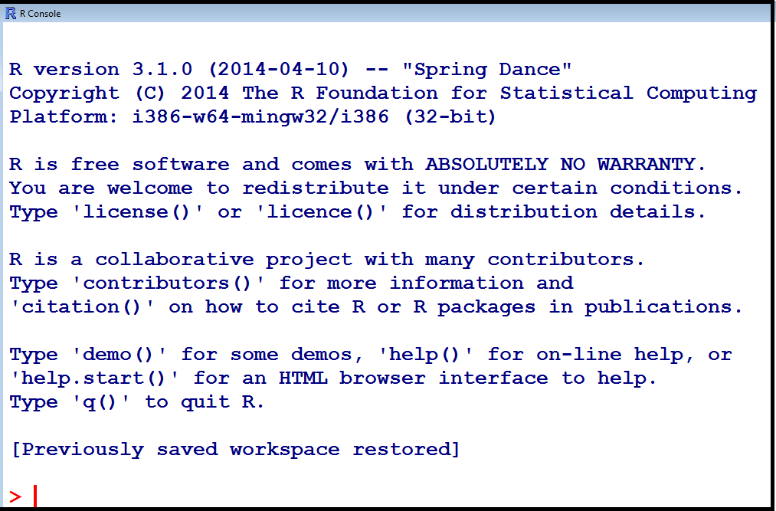
R Programming Course
3.1 R console

Slide 4
R Programming Course
3.1 R console - continued
The R Console allows command editing.
You will find that the left and right arrow keys, home, end, backspace, insert, and delete work exactly as you would expect.
You also get a command history; the up and down arrow keys can be used to scroll through recent commands.
Thus, if you make a mistake all you need to do is press the up key to recall your last command and edit it.

Slide 5
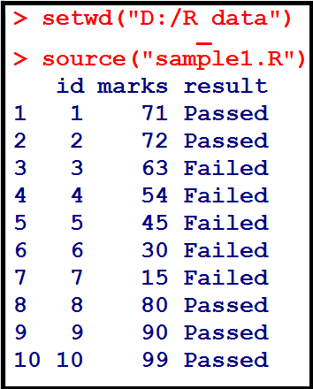
R Programming Course
3.1 R console - continued
It is possible to prepare commands in a file and then have R execute them using the source function.

Slide 6
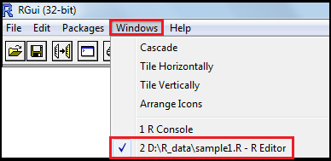
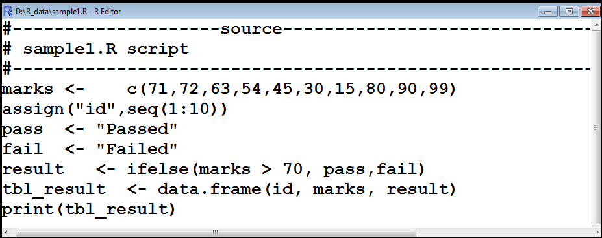
R Programming Course
3.1 R console - continued

Slide 7
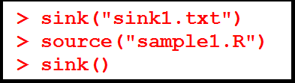
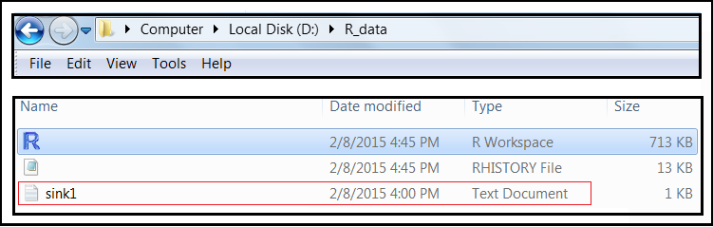
R Programming Course
3.1 R console - continued
You can send the output to a file instead of the R Console by using the sink function.

Slide 8
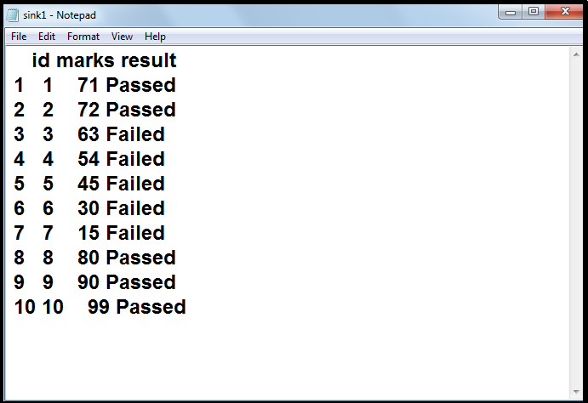
R Programming Course
3.1 R console - continued

Slide 9
R Programming Course
3.2 Getting Help
Following commands show how to invoke R help system :
help() # gives information about the help system.
help(mean) # gives extra information about the mean function.
?mean # gives extra information about the mean function. This function does the same as help(mean).
help(“if") # If you are searching for a function with special characters, then you must enclose those special characters with double quotes. You also have to do this for functions including the words: if, for and.
Note: # indicates the commencement of a comment line

Slide 10
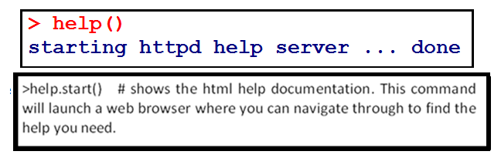
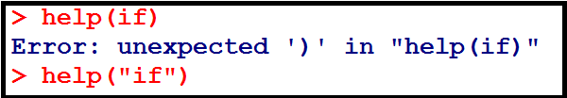

R Programming Course
3.2 Getting Help - continued
If you are not sure about the name of the function you are looking for, you can perform a fuzzy search with the apropos().

Slide 11
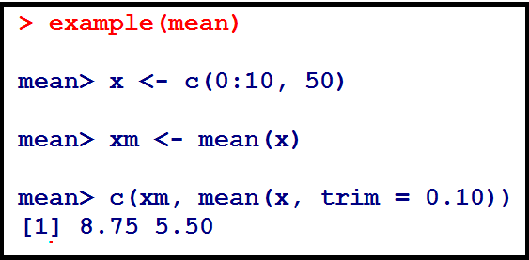
R Programming Course
3.2 Getting Help - continued
The function example() in utils package run all the R code from Examples part of R’s topic with two possible exceptions, dontrun and dontshow.
For more details, refer to http://127.0.0.1:14321/library/utils/html/example.html
For, R FAQ, please refer to
http://CRAN.R-project.org/doc/FAQ/R-FAQ.html
Author is Kurt Hornik, year = 2014)

Slide 12
R Programming Course
3.3 R environment
The workspace is your current R working environment and includes any user-defined objects (vectors, matrices, data frames, lists, functions).
At the end of an R session, the user can save an image of the current workspace that is currently reloaded the next time R is started.
You should keep different projects in different physical directories.
Assume you have created a directory, "R" in the D drive and you want to use this as your current working directory.

Slide 13
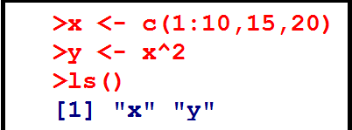
R Programming Course
3.3 R environment - continued
The following commands help you to manage your workspace:
setwd("D:/R") # to set the current working directory
getwd() # print the current working directory
ls() # list the objects in the current workspace
options() # to view the current option settings
Define objects, vectors x and y and list the objects in the current workspace.

Slide 14
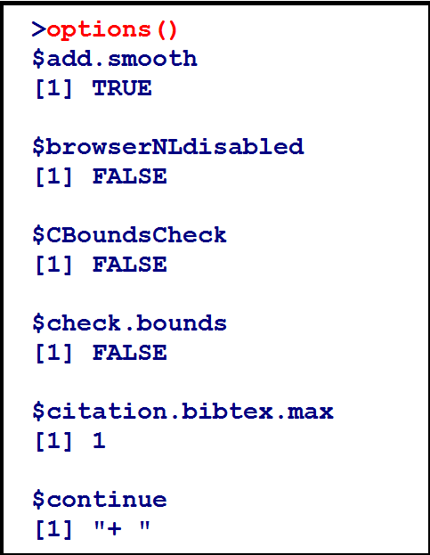
R Programming Course
3.3 R environment - continued

Slide 15
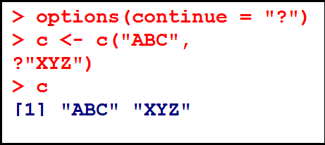
R Programming Course
3.3 R environment - continued
You can change the default continue character “+” to “?”.

Slide 16

R Programming Course
3.3 R environment - continued
You can change the default prompt character from “>” to “$”.

Slide 17
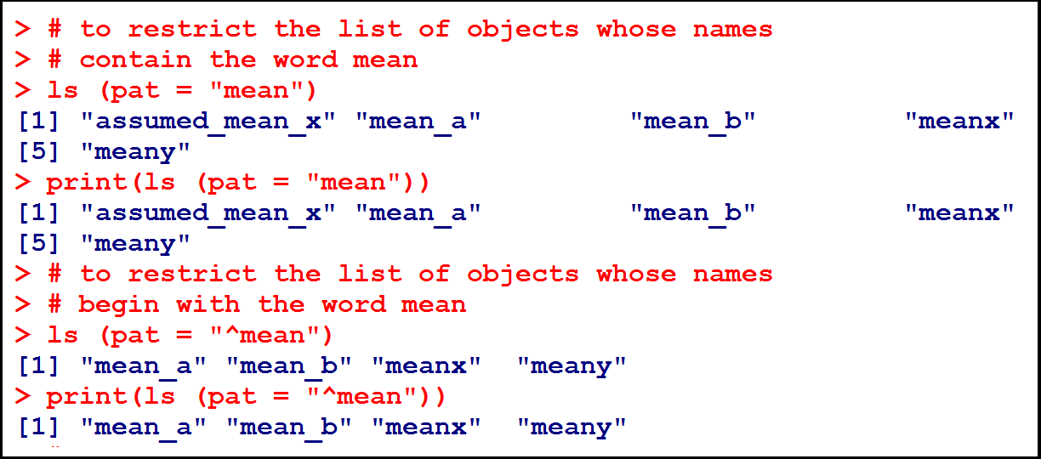
R Programming Course
3.3 R environment - continued
If you want to list the objects which contain a given character in their name, the option pattern (which can be abbreviated with pat) can be used:

Slide 18
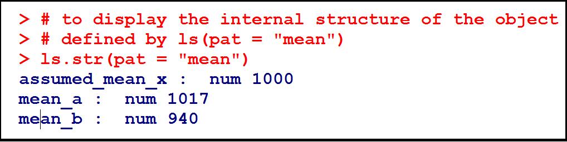
R Programming Course
3.3 R environment - continued
The function ls.str displays some details on the objects in memory.

Slide 19
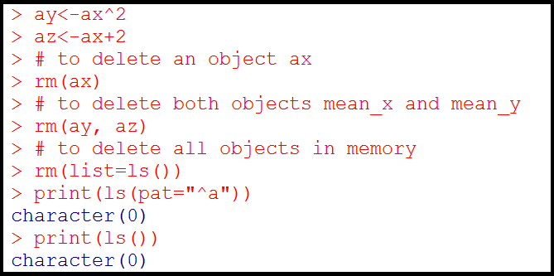
R Programming Course
3.3 R environment - continued
To delete the objects in memory, we use the functions rm:
rm(x) deletes the object x
rm(x,y) deletes both x and y
rm(list=ls()) deletes all the objects in memory.

Slide 20
R Programming Course
3.4 Managing objects in memory
An object can be created with the assign operator “<-“ ; this symbol can be oriented left-to-right or the reverse.
All objects have two intrinsic attributes: mode and length.
The mode is the basic type of the elements of the object; there are four main modes, namely, numeric, character, complex and logical
The length is the number of elements in the object.

Slide 21
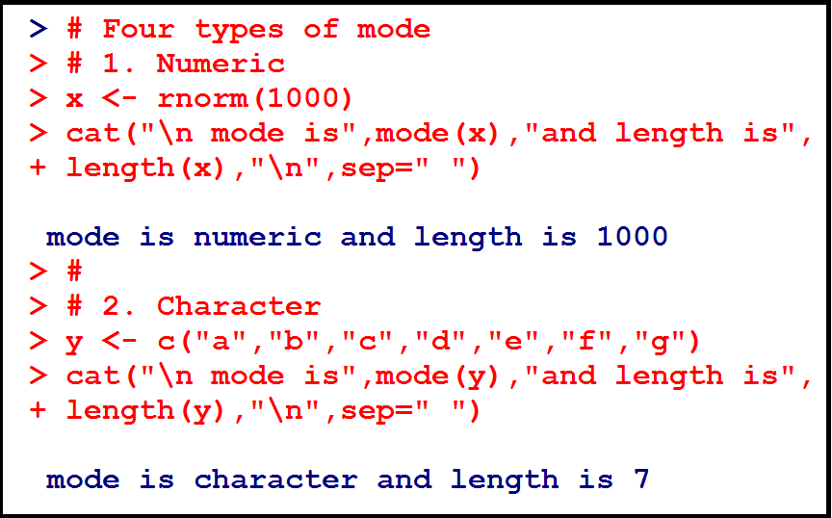
R Programming Course
3.4 Managing objects in memory - continued
The value assigned may be the result of an operation and / or a function, like The function rnorm(1) generates a normal random variable with mean zero and variance unity.

Slide 22
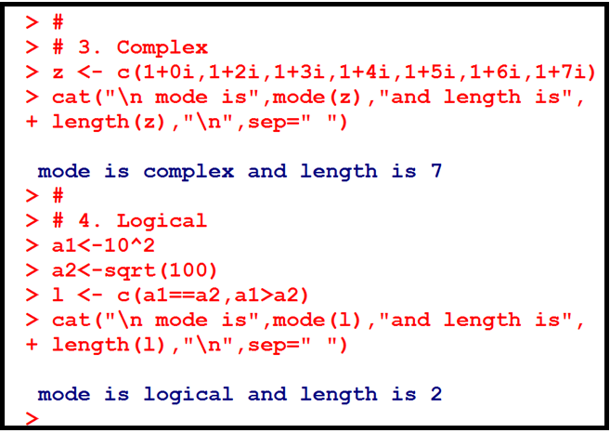
R Programming Course
3.4 Managing objects in memory - continued

Slide 23
R Programming Course
3.5 Customizing R environment
You can customize the R environment through a site initialization file or a directory initialization file.
At start up, R will source the Rprofile.site file.
It will then look for a .Rprofile file to source in the current working directory.
There are two special functions you can place in this file.
.First() will be run at the start of the R session and .Last() will be run at the end of the session.
To quit the session, type quit() or its alias q() to quit R.
At that point, you will be asked if you want to save the workspace image. This save will save all the work you have done so far, and load it up when you next start R.

Slide 24
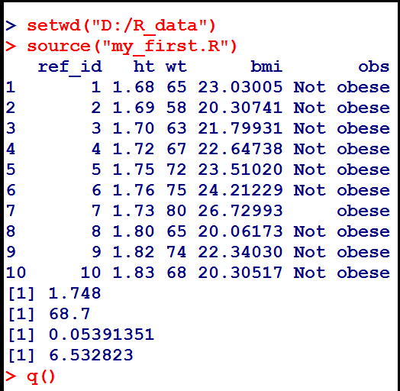
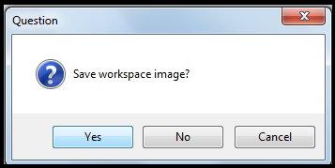
R Programming Course
3.5 Customizing R environment

Slide 25
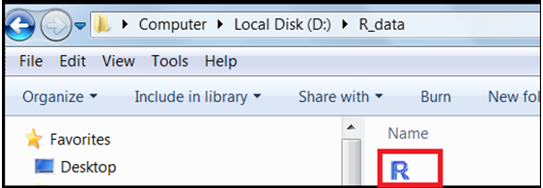
R Programming Course
3.5 Customizing R environment
Create a file (.Rprofile) as follows and place it in D:/R_data.
Create function .First() to do the following:
1. Set working directory to D:/R_data
Print a welcome message by printing the date and the current working directory.
Double click on the R icon in the D:/R_data directory.

Slide 26
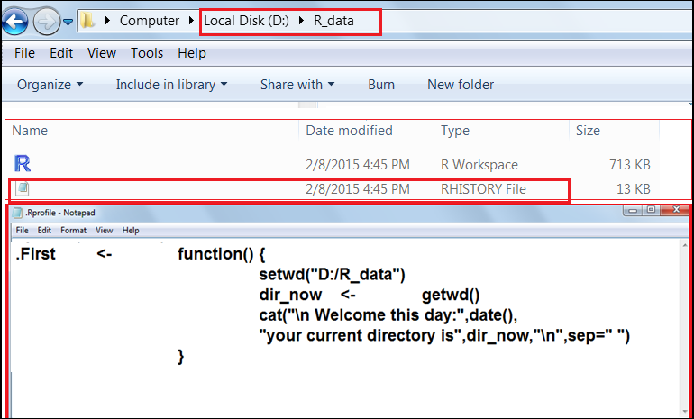
R Programming Course
3.5 Customizing R environment

Slide 27
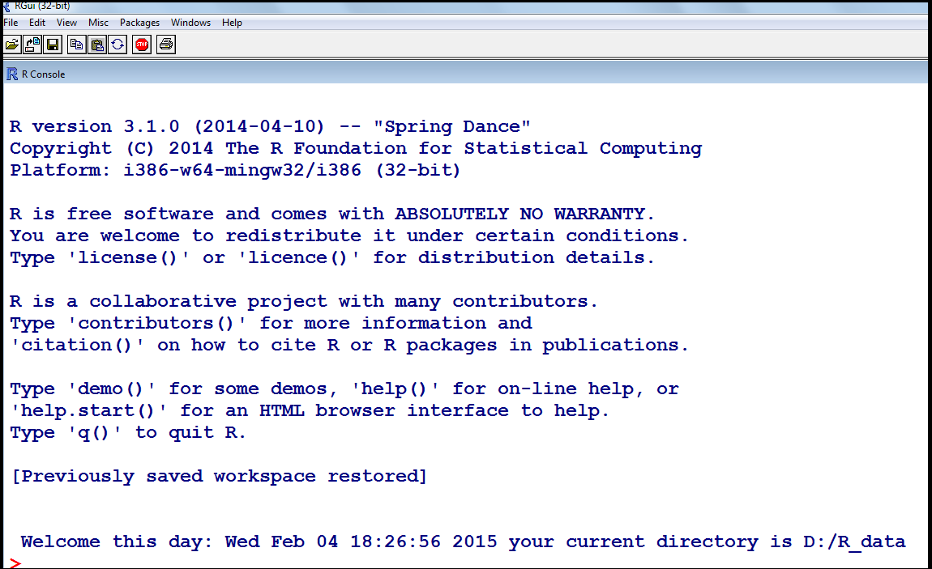
R Programming Course
3.5 Customizing R environment

Slide 28
R Programming Course
3.6 Text Editors and Integrated Development
Graphical User Interfaces (GUI) include:
1. RGui - comes with the pre-compiled version of R for Windows
2. RStudio - cross-platform open source Integrated Development Environment (IDE) (which can also be run on a remote linux server)
Editors and IDEs
Text editors and IDEs with some support for R include:
jEdit, Eclipse (StatET), Rstudio and Tinn-R

Slide 29
R Programming Course
3.7 R Environment (IDE)- R Studio
RStudio projects are associated with R working directories.
Rstudio has four panels.
Bottom left: Console panel
The console is where you can type R commands and see output.
Top left: Editor panel
Here, collection of commands or scripts can be edited and saved.
Top right: environment/ history panel
In the environment tab, you see data and values R has in memory.
The history tab shows what was typed before.

Slide 30
R Programming Course
3.7 R Environment (IDE)- R Studio
Bottom Right: files/ plots/ packages/ help / viewer panel
The file tab shows all the files and folders in your default workspace.
The plots tab shows all your graphs.
The packages tab shows lists the series of packages or add-ons needed to run certain proceses.
For additional help see the help tab.
The Viewer tab displays local web content (e.g. graphical output).

Slide 31
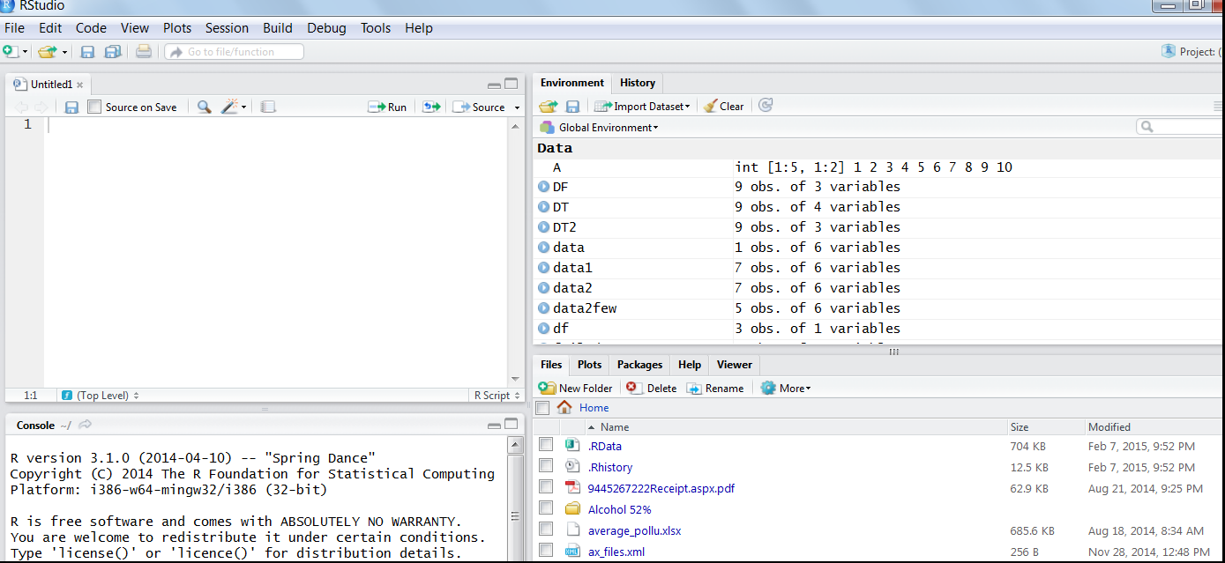
R Programming Course
3.7 R Environment (IDE)- R Studio

Slide 32
R Programming Course
3.8 Working with Projects in RStudio
Projects help you to manage your work with R language very easily by dividing into multiple contexts, each with their own working directory, workspace, history and source documents.
RStudio projects are associated with R working directories.
Let us create a project “1_Project”.

Slide 33
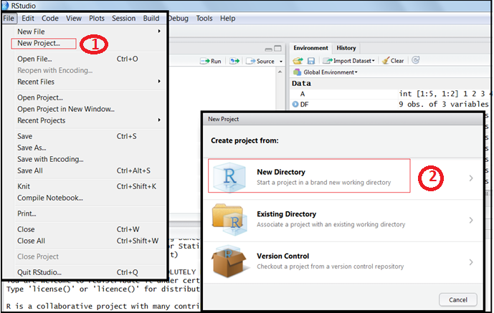
R Programming Course
3.8 Working with Projects in RStudio

Slide 34
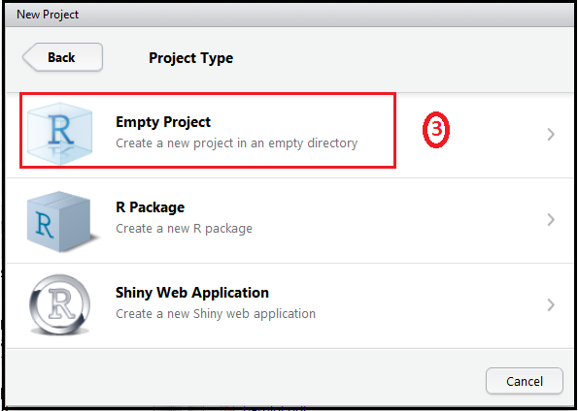
R Programming Course
3.8 Working with Projects in RStudio

Slide 35
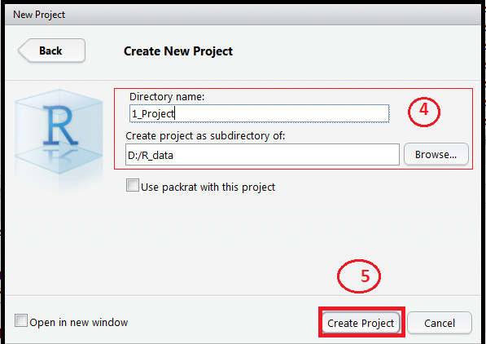
R Programming Course
3.8 Working with Projects in RStudio

Slide 36
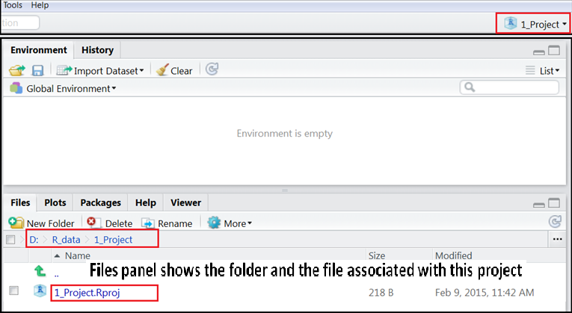
R Programming Course
3.8 Working with Projects in RStudio
Now you can see the new project, 1_Project in the right most corner of the RStudio window.

Slide 37
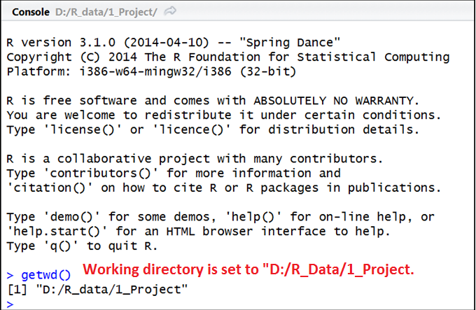
R Programming Course
3.8 Working with Projects in RStudio

Slide 38
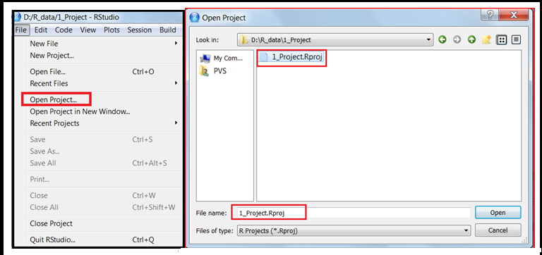
R Programming Course
3.8 Working with Projects in RStudio
Open the project, 1_Project as shown below:
Load the program my_first.R and run the same

Slide 39
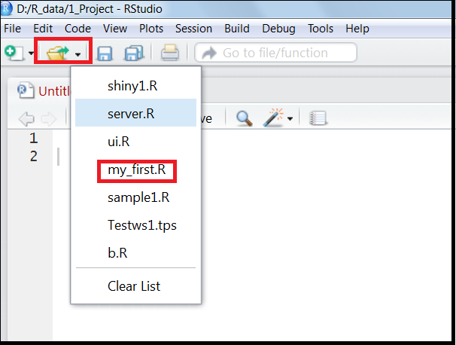
R Programming Course
3.8 Working with Projects in RStudio

Slide 40
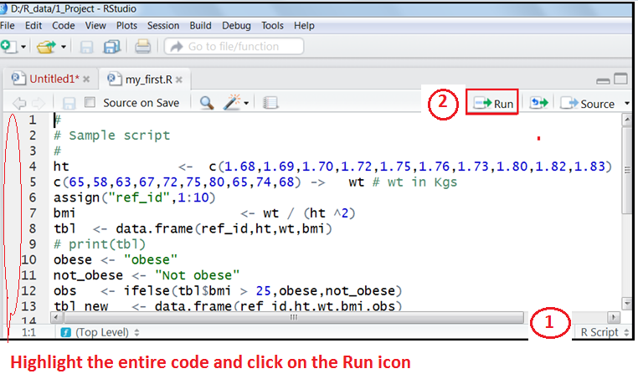
R Programming Course
3.8 Working with Projects in RStudio
The script is executed in the console panel and the output is displayed.

Slide 41
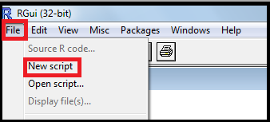
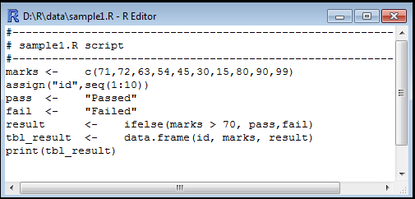
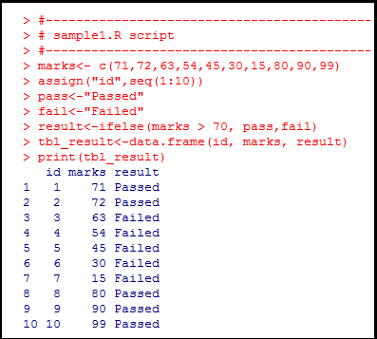
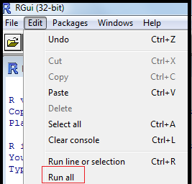
R Programming Course
3.9 Writing and executing R Scripts

Slide 42

R Programming Course

Slide 43
R Programming Course
Comment lines in R begin with the symbol “#”.
Always True
Always False
May or may not be true
I do not know the answer
The command help(mean) does the following:
I It gives extra information about the mean function.
II It searches the complete documentation for the word mean
Statement I is True and Statement II is false
Statement II is True and Statement I is false
Both the statements are False
Both the statements are true

Slide 44
R Programming Course
If you are not sure about the name of the function you are looking for, you can perform a fuzzy search with the __________ function.
help()
apropos()
search()
None of the above
The function ________ in utils package run all the R code from examples part of R’s topic .
example()
help()
All of the above
None of the above

Slide 45
R Programming Course
Comment lines in R begin with the symbol “#”.
Always True
The command help(mean) does the following:
I It gives extra information about the mean function.
II It searches the complete documentation for the word mean
Statement I is True and Statement II is false
If you are not sure about the name of the function you are looking for, you can perform a fuzzy search with the __________ function.
apropos()
4. The function ________ in utils package run all the R code from examples part of R’s topic .
example()

Slide 46
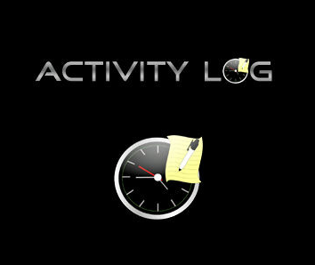
R Programming Course

Slide 47
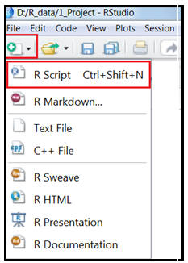
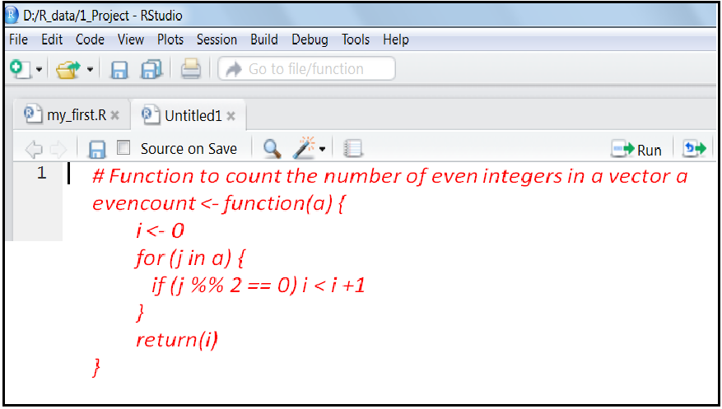
R Programming Course
Lab Exercise 1:
Write the function in RStudio as shown below:

Slide 48
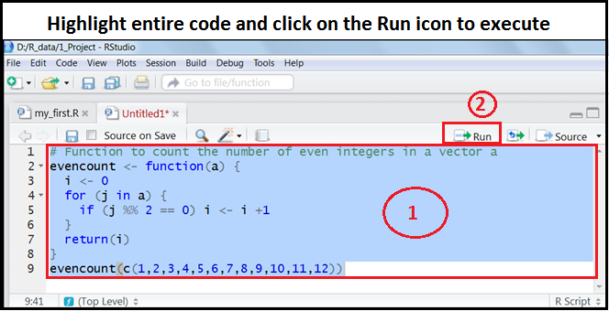
R Programming Course
Lab Exercise 2:
Execute the function in RStudio as shown below:

Slide 49
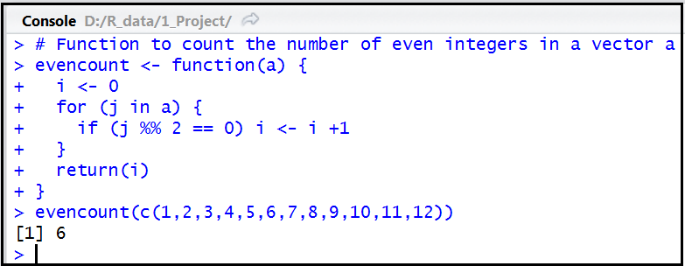
R Programming Course
Check whether you have obtained the results as shown below:

Slide 50
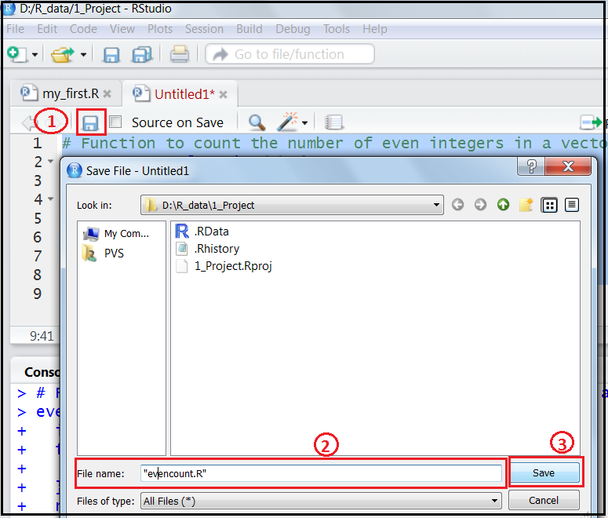
R Programming Course
Lab Exercise 3:
Save the code as “evencount.R” in RStudio as shown below:

